Slide 1
Experiences in implementing pan-European Services using national INSPIRE services: The integration perspective Anja Hopfstock, BKG, 24.10.2019

Slide 2
Agenda
Assembling multi-country datasets – centralized approach
Core Reference Dataset (CRD)
Data integration experiences – lessons learned

Slide 3
Assembling multi-country datasets
Decentralized approach
National INSPIRE services
European Location Services
automatic harvesting
assumed to be complete, quality assured and harmonized
services
multi-purpose
all topographic INSPIRE themes
pan-European coverage
Centralized approach
National INSPIRE services
Core Reference Dataset (CRD)
Assembling and harmonization by central production team
dataset
specific use case
limited content, simplified INSPIRE
pan-European coverage
assumed to be complete and quality assured
Notes:
CRD defined ad hoc based on CLC+ (Backbone) request.
CRD specified mainly based on CLC+, but taking into account all known demands within the EC and its Institutions (collected by EG under ELS).
Decision for centralized approach taken because of ELS experiences:
National INSPIRE services are lacking harmonization between countries, between themes, selection criteria, level of detail, …
Automatic harvesting is working only in theory
Central production team is more flexible
Keep workload for data providers low
Basic assumptions: necessary data available (all themes are from Annex I), data is provided by INSPIRE service, data is quality assured; harmonisation is achieved by reducing the content to only few attributes and feature types; cross-border harmonisation done by production team

Slide 4
Core Reference Dataset (CRD)
Core Reference Dataset
EuroGeographics wanted to create a
Reference Data set (not a service)
at Master Level of Detail (scale 1:10.000 to 1:50.000)
for all of Europe → provided through one Point of Contact
make use of INSPIRE- / ELS-Data provided by NMCAs
But:
Limited content, only few themes, only basic attribute information → “Core”
Easy to use → Simplified data model
Harmonised at international boundaries
Centralised data production

Slide 5
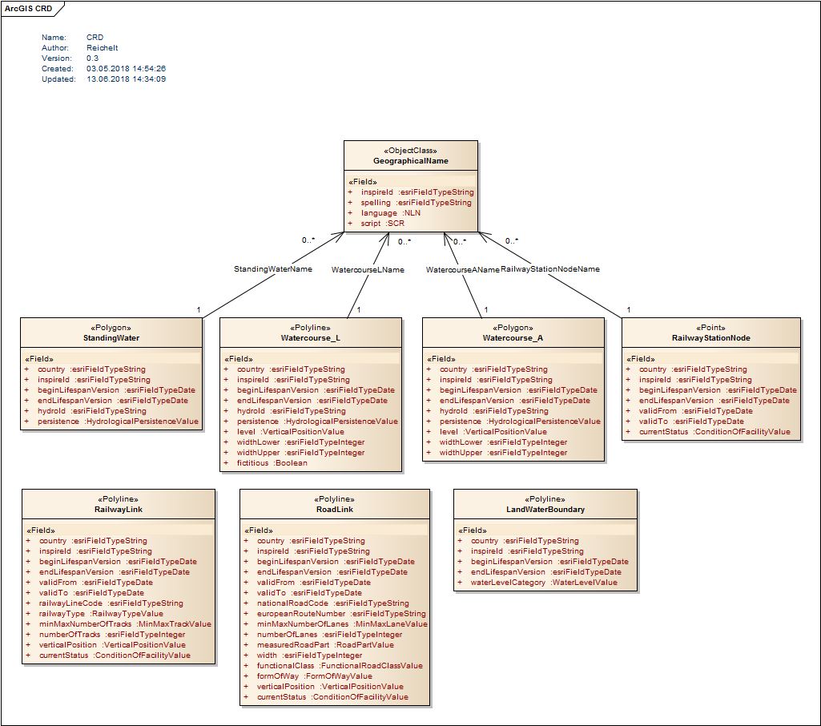
Easy to use
Core Reference Dataset
Limited content
Hydrography: Watercourse, StandingWater, LandWaterBoundary
Transport Network: Road Network, Railway Network including RailwayStationNode
Only few basic attributes
Simplified data model
Flat structure means:
Only direct attributes for properties
No connected tables (except for Geographic Names)
No linear referencing
Only one geometry type per feature

Slide 6
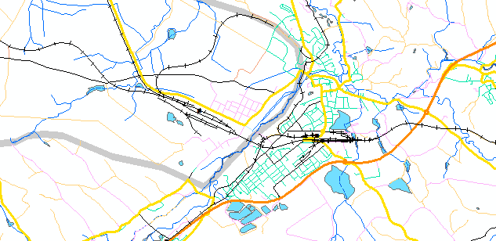
Production steps by central production team:
Core Reference Dataset
Receiving data delivery from NMCAs → mainly as dataset and not by services
If needed: transformation to CRD data model
Basic quality checks → but CRD relies on the quality checks done by NMCAs for the original data
Edge matching on international boundaries → semi-automatic
Final assembly of CRD → documentation, metadata
Prototype of CRD including 3 countries: Austria, Czech Republic, Slovakia

Slide 7
Assumptions at the beginning
Data integration experiences
Data delivery: INSPIRE data delivered by INPIRE service (download service, WFS)
Transformation: done by production team
Content: all content available → Annex I themes
Data quality: data is quality checked as data is the official national INSPIRE data
Edge matching: main task of the production team

Slide 8
Lessons learned: data delivery
Data integration experiences
WFS not suitable because:
Access difficult (because text only in national language)
Download of whole country not possible
Connections not stable
In some countries: Complex registration procedures (in national language)
Recommendations for data providers:
Make data available as downloadable dataset
Avoid complex access restrictions → provide real open data
Notes:
Data providers usually fulfill the demands on download services (INSPIRE Directive, Chapter IV Network Services, Articel 11) – but the national implementations with specific software and specific access restrictions make it hard to use the download services.
INSPIRE focus on WFS with GML is narrowing the usage. (WFS are not designed to download mass data.)

Slide 9
Lessons learned: transformation
Data integration experiences
Data provider prefer direct transformation to simplified CRD model, because:
INSPIRE data models too complex
National INSPIRE implementation obviously not perfect
Recommendations for INSPIRE evolvement:
Simplify data models and streamline the models of the different themes
Recommendations for data providers:
Take INSPIRE implementation serious and provide meaningful content
Collaborate with other data providers to understand the INSPIRE data models and its implementation
Notes:
The initial idea was to keep the workload for the data providers as low as possible and to take the national INSPIRE data and transform it to CRD data model centrally (by production team).
Data providers realised that the content in their INSPIRE data is not sufficient to fulfil the requirements of CRD, e.g. additional data sources are needed.
Data providers are not really commited to the INSPIRE process and don’t see the benefits. INSPIRE is seen as an obligation, which has to be fulfilled with as small workload as possible.
Each INSPIRE theme appears as a silo, developed more or less independent from each other. Beside the core INSPIRE concepts, each TWG has defined its theme with an own conceptual model.

Slide 10
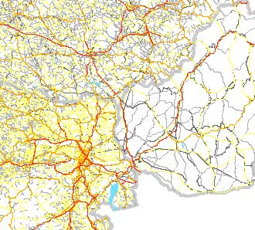
Lessons learned: data content (I)
Data integration experiences
Not all information (feature types, attributes) available as INSPIRE data → some countries use additional sources for CRD
Voidable (and even mandatory) attributes empty
Common understanding of selection criteria is critical
→ semantic harmonisation
Missing attribute values (Example RoadLink):
Country | InspireId | Begin Lifespan Version | End Lifespan Version | ValidFrom | ValidTo | National RoadCode | European Route Number | MinMax NumberOf Lanes | NumberOf Lanes | Measured RoadPart | Width | Functional Class | FormOf Way | Vertical Position | Current Status
A | 100 | 100 | 0 | 0 | 0 | 6 | 0 | 100 | 100 | 0 | 0 | 100 | 100 | 100 | 100
B | 100 | 100 | 0 | 0 | 0 | 28 | 0 | 0 | 0 | 0 | 0 | 100 | 0 | 100 | 100
C | 100 | 100 | 0 | 0 | 0 | 13 | 0 | 0 | 0 | 100 | 53 | 100 | 100 | 100 | 98
D | 100 | 100 | 0 | 0 | 0 | 11 | 1 | 86 | 86 | 86 | 86 | 100 | 100 | 100 | 86
E | 0 | 0 | 0 | 0 | 0 | 4 | 0 | 0 | 100 | 98 | 0 | 97 | 100 | 99 | 100
F | 100 | 100 | 0 | 0 | 0 | 47 | 1 | 0 | 30 | 0 | 0 | 100 | 100 | 100 | 100
G | 100 | 0 | 0 | 0 | 0 | 15 | 0 | 0 | 54 | 100 | 54 | 89 | 100 | 100 | 100
H | 0 | 0 | 0 | 0 | 0 | 31 | 0 | 0 | 0 | 0 | 0 | 100 | 100 | 0 | 100
I | 100 | 100 | 0 | 0 | 0 | 100 | 0 | 0 | 0 | 0 | 0 | 0 | 0 | 0 | 0
Varying density of road network
Notes:
even the reduced content of CRD cannot be fulfilled using INSPIRE data

Slide 11
Lessons learned: data content (II)
Data integration experiences
Recommendations for INSPIRE evolvement:
Make relevant attributes mandatory
Recommendations for data providers:
Provide as much information as possible
Take into account the use cases
Respect the recommendations for core content and selection criteria of topographic data (see ELF as well as UN-GGIM: Europe)
Notes:
NMCAs have to put more effort into the production of their national INSPIRE data.
Without some common attributes filled in by all NMCAs the usability of INSPIRE data for cross border use cases will be very limited.

Slide 12
Lessons learned: data quality
Data integration experiences
Even simple quality checks show errors (short lines, geometrical errors, gaps between adjoining surfaces, semantic errors)
Recommendations for INSPIRE evolvement:
Provide requirements for data quality
Recommendations for data providers:
Improve data quality of national source data
Implement quality checking workflow
Document data quality

Slide 13
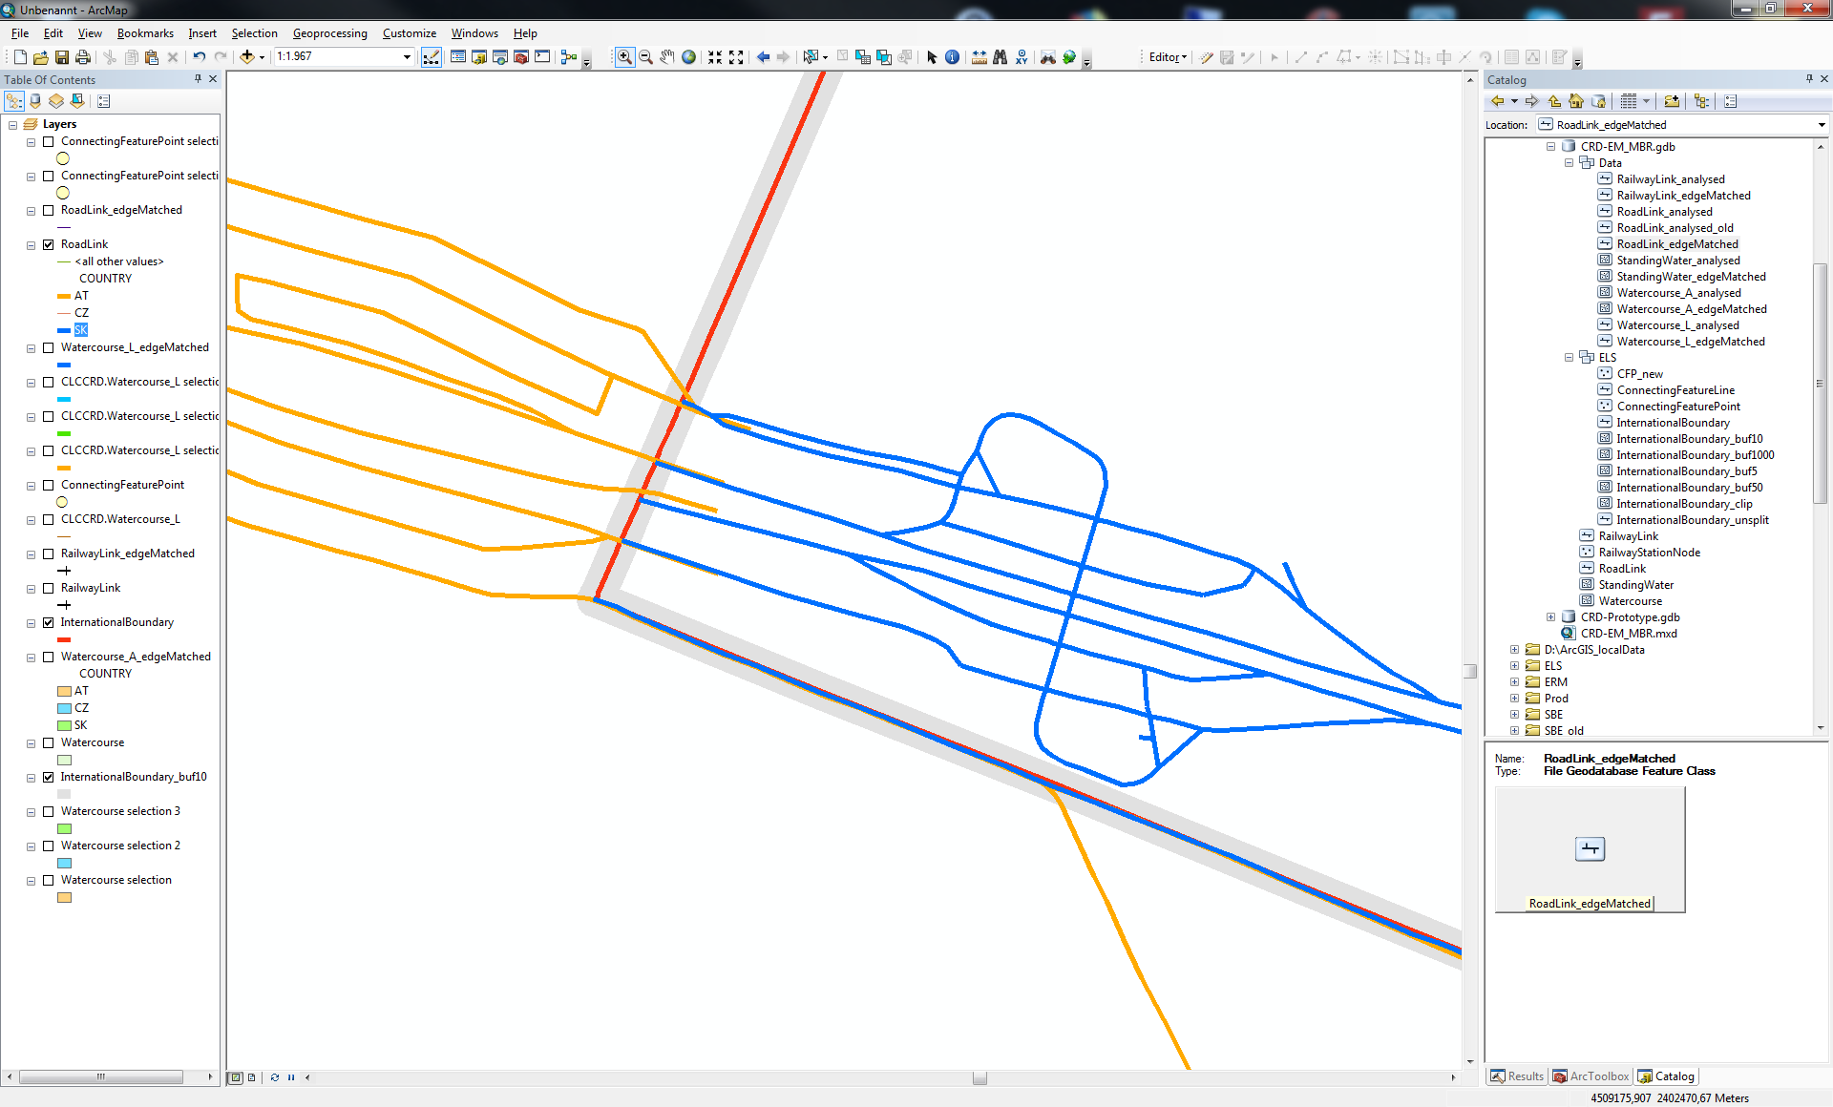
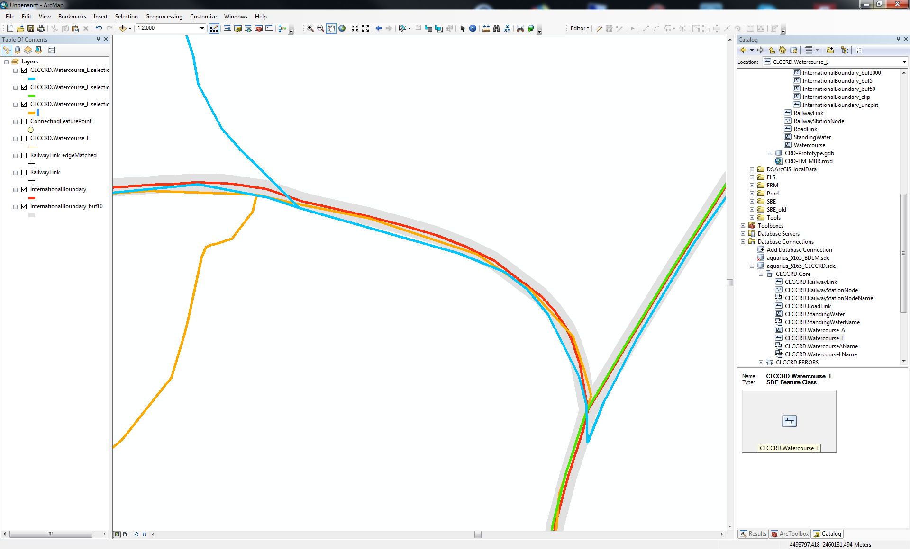
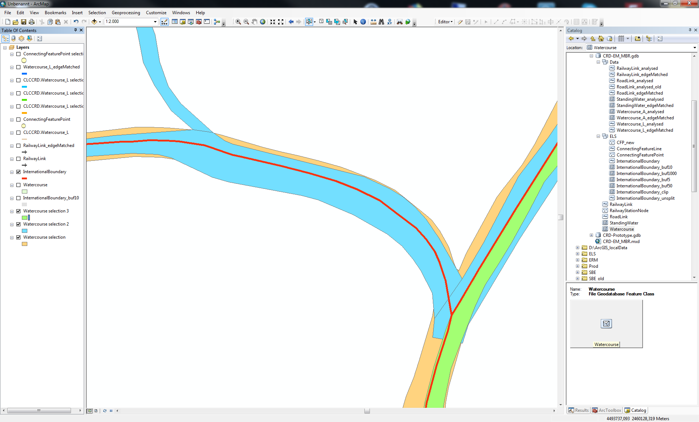
Lessons learned: edge matching
Data integration experiences
Neighbouring countries use different boundary lines
Delivered data overlapping neighbouring country
Recommendations for data providers:
Agree on common border represenation with neighboring countries
Edge match national source data to reach cross-border harmonisation of topographic data
Notes:
This was assumed to be the biggest workload for the production team. Edge matching has not been done along most borders for INSPIRE data.
INSPIRE Directive
Chapter III – Interoperability of spatial data sets and services
Article 10 - In order to ensure that spatial data relating to a geographical feature, the location of which spans the frontier between two or more Member States, are coherent, Member States shall, where appropriate, decide by mutual consent on the depiction and position of such common features.

Slide 14
Summary: Lessons learned
Data integration experiences
Recommendations for INSPIRE evolvement:
Simplify data models and streamline the models of the different themes
Make relevant attributes mandatory
Recommendations for data providers:
Make data available as downloadable dataset → simplify access to data
Deliver meaningful content → use cases „topographic data“
Respect the recommendations for core content and selection criteria of topographic data
Collaborate with other data providers to understand the INSPIRE data models and its implementation → achieve better semantic harmonisation across borders
Edge match national source data → achieve better geometric harmonisation across borders

Slide 15
Thank you for your attention
Core Reference Dataset
Contacts
EuroGeographics:
Primary contact, Pricing and Licensing: angela.baker@eurogeographics.org
BKG
CRD Production team: sonja.werhahn@bkg.bund.de

